Slide 1

AngularJS Basics & Best Practices
Competence Center Front-end & UX
Dennis Jaamann & Frédéric Ghijselinck Front-end devs

Slide 2
AngularJS Basics & Best Practices
What is AngularJS?
Why AngularJS?
Framework features
Framework components
Unit Testing With Karma
Best Practices

Slide 3
1. What is AngularJS?
JavaScript MVVM framework
Started in 2009 by Miško Hevery (Google)
Declarative HTML
Easy to create your own DSL
Decoupling of DOM manipulation and application logic

Slide 4
2. Why AngularJS
Becoming an industry standard for enterprise applications
Large community
Very active project
Mature JavaScript framework
Improved JavaScript development experience
Structured JavaScript applications
Separation of concerns
Testability
Modularity
Maintainability
Productivity
Lots of tooling around AngularJS
Documentation is not the best around

Slide 5
3. Framework features
No
Class (inheritance)
Interfaces
Type safety
Place for storing data models
Yes
MVVM
IOC container (DI)
Two way data binding
Testable javascript code
Separation of concerns

Slide 6
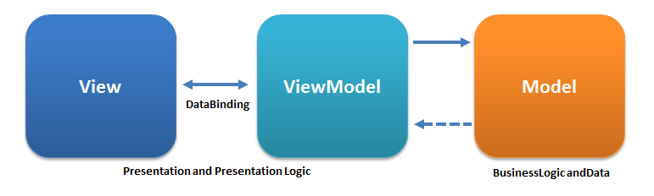
3. Framework features - MVVM
Angular is uses MVVM
View
HTML with Angular syntax
ViewModel
Known in Angular as $scope
In view controllers
In directives
Model
Services

Slide 7
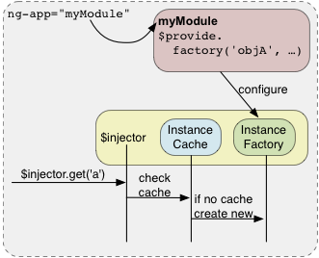
3. Framework features - Dependency Injection
Angular uses dependency injection
Constructor injection by default
Manual injection also possible
Loose coupling of application components
Controllers
Services
Directives
...

Slide 8
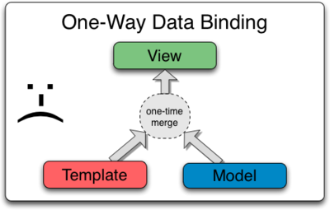
3. Framework features - 2-way data binding
Classic frameworks use 1-way databinding
Merge model and template to show view
Updates to model not automatically reflected
A lot of manual code needs to be written to update the view when the model changes
More code === more bugs

Slide 9
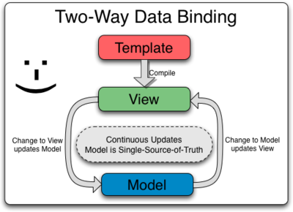
3. Framework features - 2-way data binding
AngularJS uses 2-way databinding
Template compiled to view
Updating
On view update ⇒ Update model
On model update ⇒ update view
“Dirty checking” used to know what to update
“Model” === $scope
Automatic process
Less code === less bugs

Slide 10
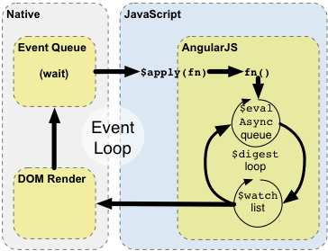
3. Framework features - Dirty checking
Browser API’s suck currently (no Observables for DOM objects to know when something changes)
Angular needs a manual loop to know
Whether the DOM element changed and update the model
Whether the model changed and update the view
Multiple passes by default
Only update when scope remains unchanged for x passes
Maximum 10 passes
Pitfall
Dirty checking can slow down application substantially
Potentially uses a lot of CPU cycles
Keep objects/functions on your $scope as few as possible
Less updates === less dirty checks

Slide 11


3. Framework features - Testable JavaScript code
Angular core team wrote unit test runner called Karma
Adapters for most common unit testing frameworks
Jasmine (default, preffered)
Mocha
QUnit
Integrates well with automation tools to setup CI
Grunt
Gulp
Integration test library called Protractor
NodeJS powered
Based on WebDriverJS
Mocks library to easily mock out dependencies
angular-mocks

Slide 12
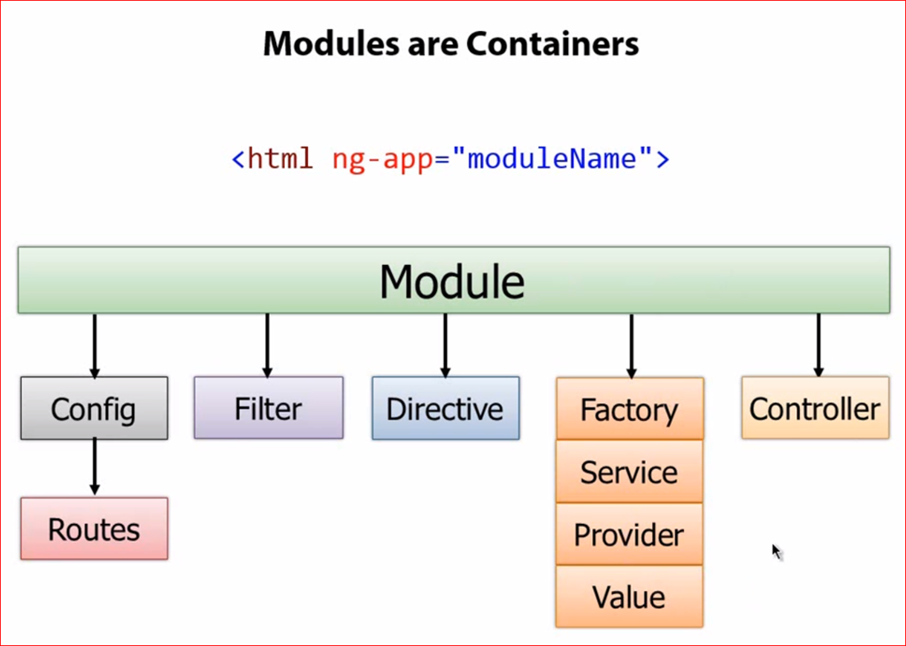
4. Framework components - Module
Modules are containers for application components
At least 1 module needed (main module)
Can have submodules
No out of the box lazy loading
Plugins exist

Slide 13
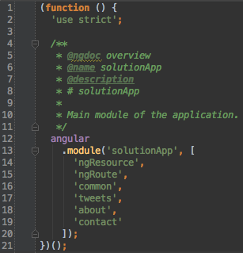
4. Framework components - Module
Example of a main module with submodules

Slide 14
4. Framework components - Scope
Also known as view model in other frameworks
Single source of truth
Variables
Functions
Use in
Controllers
Directives
Avoid in
Services
Sibling scopes cannot talk to each other ⇒ use events
$broadcast / $emit
$on / $watch

Slide 15
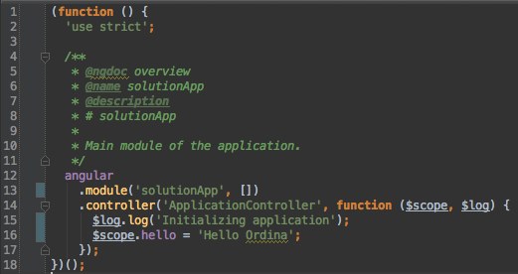
4. Framework components - Scope
Inject $scope as a dependency
$scope can contain variables and functions as members

Slide 16
Exercise 1 - Bootstrap your application
Switch to branch exercise1
In index.html
TODO 1 - Bootstrap your angular application and add controller 'ApplicationController'
TODO 2 - Load app.js
In app.js
TODO 3 - Create a controller 'ApplicationController' on the module, pass $scope and $log
TODO 4 - Log 'initializing application'
TODO 5 - Create a scope variable called 'hello', with content 'Hello Ordina'
In index.html
TODO 6 - Show the scope variable 'hello'

Slide 17

4. Framework components - View
Also called templates or partials
Regular HTML enhanced with
Angular directives
Custom directives
Expressions {{ someExpression }}

Slide 18
4. Framework components - View
Don’t
Complex logic in expressions in view
Refactor to scope function when possible
Keep data-ng-controller directives out of your view
Decouple view from controller (Reusability)
Do
Invoke scope functions
Display scope variables

Slide 19
Exercise 2 - Leveraging modules and including views
Switch to branch exercise2
In index.html
TODO 1 - Remove the application controller
TODO 2 - Import scripts/common/module.js
TODO 3 - Import scripts/common/controllers/navigationController.js
In scripts/common/module.js
TODO 4 - Create and instantiate a new module called 'common'
In app.js
TODO 5 - Remove the controller
TODO 6 - Inject the common module
In index.html
TODO 7 - Create a new file views/common/navigation.html and include

Slide 20
Exercise 2 - Leveraging modules and including views
In scripts/common/controllers/navigationController.js
TODO 8 - Create new controller on common module, inject $scope and $window
TODO 9 - Create a new function onItemClick(item) on the scope, $window.alert the item

Slide 21
4. Framework components - Controller
Don’t
No DOM interactions ⇒ Encapsulate DOM interaction in directives
No data manipulation ⇒ Encapsulate data manipulation in services
Put everything on the scope ⇒ only what is needed (dirty checking performance)
Share code/state between different controllers
Manage lifecycle of other components
Ajax requests ⇒ Encapsulate Ajax requests in services
Do
Scope variables
View related logic
Callbacks
Handlers
Broadcasts
...

Slide 22
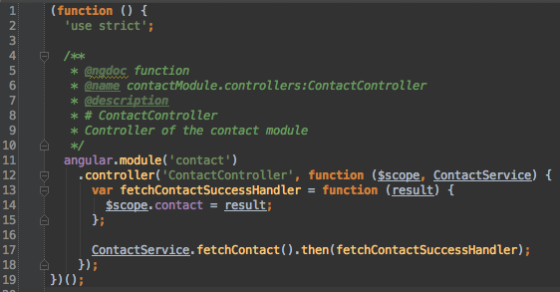
4. Framework components - Controller
Controller example

Slide 23
4. Framework components - Router
Angular Module
Configure which template/controller pair to use
Keep data-ng-controller directive out of your HTML ⇒ use template with different controllers
A route can be configured and consists of
Template or TemplateUrl (required)
Controller (required)
Resolver (optional)
Deeplinking out of the box

Slide 24
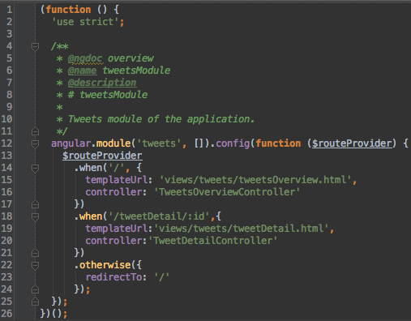
4. Framework components - Router
Example of route configuration

Slide 25
Exercise 3 - Using routes and deeplinking
Switch to branch exercise3
In index.html
TODO 1 through 6 - Import the correct files
TODO 7 - Create a div with a data-ng-view directive to enable routing
In app.js
TODO 8 - Inject ngRoute module
TODO 9 - When default route, load tweetsOverview.html and use TweetsOverviewController
TODO 10 - When /about, load about.html and use AboutController
TODO 11 - When /contact, load contact.html and use ContactController
TODO 12 - Otherwise redirect to default route
In navigation.html
TODO 13 - Provide the correct data-ng-href for each link

Slide 26
4. Framework components - Service
Don’t
DOM manipulation
Redirect to a route
Manipulate lifecycle of other components
Do
Ajax requests
Encapsulate complex business logic
Data manipulation
Filtering / Sorting

Slide 27
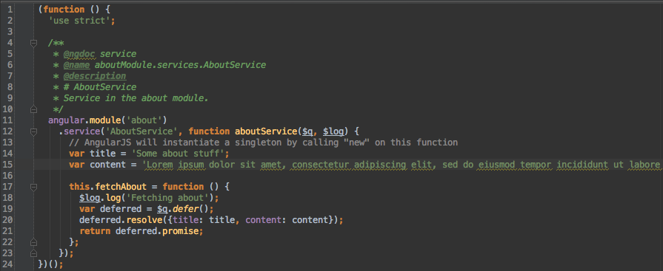
4. Framework components - Service
An example of a service

Slide 28
Exercise 4 - Creating a service
Switch to branch exercise4
In index.html
TODO 1 through 4 - Import the correct files
In app.js
TODO 5 - Inject ngResource
TODO 6 - When /tweetdetail/:id, load tweetdetail.html and use TweetDetailController
In twitterSearchService.js
TODO 7 - Create a new resource with url /doSearch?q=:searchTerm&count=10
TODO 8 - Create a new function searchTweets(searchTerm)
TODO 9 - resource.get(searchTerm) and return a promise
In twitterOverviewController.js
TODO 10 - Call searchTweetsMethods on TwitterSearchService and handle promise
TODO 11 - Create a succeshandler for tweets and put result on $scope.tweets

Slide 29
4. Framework components - Resolver
Part of a route
Preload data from a service
Inject data into controller
Less code in controller
Better testability
Better separation of concerns

Slide 30
4. Framework components - Directive
Extend HTML with custom tags
Can have a dedicated template
Can have a dedicated controller
Do any DOM manipulation here, not in controller
Has its own scope
Can have its own controller
Only use when you want to expose API for other directives
Using data-ng-include? ⇒ Refactor to use a directive

Slide 31
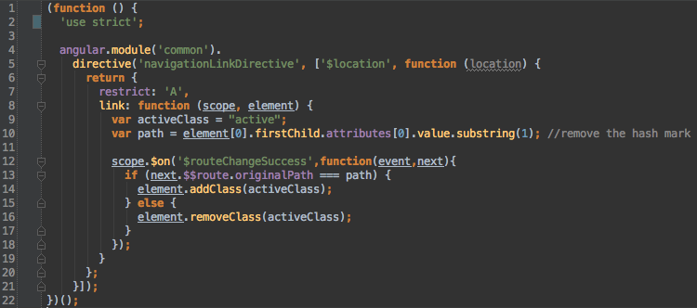
4. Framework components - Directive
Example of a directive

Slide 32
Exercise 5 - Using resolvers and directives
Switch to branch exercise5
In app.js
TODO 1 - Create a resolver fetching all tweets from the TwitterSearchService
TODO 2 - Create a resolver fetching tweet details by id from the TwitterSearchService (use $route.current.params.id)
In tweetDetailController.js
TODO 3 - Inject tweet & put on scope
In tweetsOverviewController.js
TODO 4 - Inject tweets & put tweet.statuses on scope
In tweetDirective.js
TODO 5 - Create a directive that loads tweetDirective.html (use templateUrl)
In tweetsOverview.html
TODO 6 - Use the tweetDirective

Slide 33
Exercise 5 - Using resolvers and directives
In tweetDirective.html
TODO 7 - Show the created_at date in the directive
TODO 8 - Show the tweet.user.name
TODO 9 - Show the tweet.place.name and tweet.place.country
TODO 10 - Show the tweet.user.profile_image_url in an image tag

Slide 34
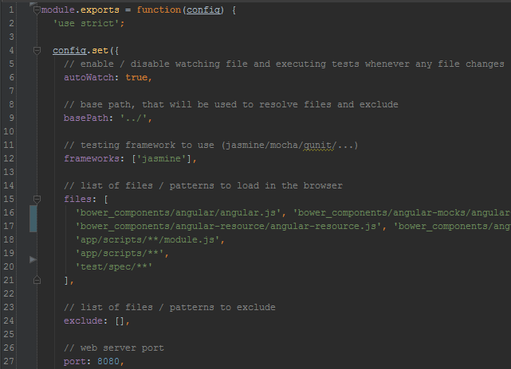
5. Unit Testing With Karma
Karma = unit test runner (by angular core team)
configuration file
test suites
headless/real browser
Automagically generate a config file
karma init
Simply run the test suite
karma start

Slide 35

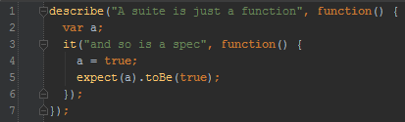
5. Unit Testing - Jasmine
Jasmine = unit testing framework
test suite with specs:

Slide 36
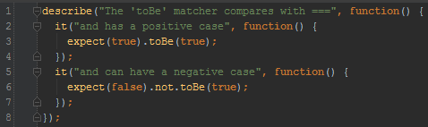
5. Unit Testing - Jasmine
included matchers:
expect().toBe(); expect().toEqual(); expect().toMatch(); expect().toBeDefined(); expect().toBeUnDefined(); expect().toBeNull(); expect().toBeTruthy(); expect().toBeFalsy(); expect().toContain(); expect().toBeLessThan(); expect().toBeGreaterThan(); expect().toBeCloseTo(); expect().toThrow();

Slide 37

5. Unit Testing - Jasmine
setup & teardown
beforeEach()
afterEach()
beforeAll()
afterAll()
Angular test
getting the module
injecting the controller

Slide 38
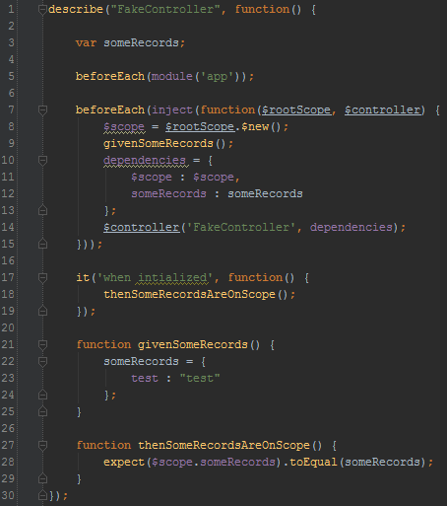
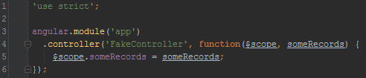
5. Unit Testing - Controller

Slide 39
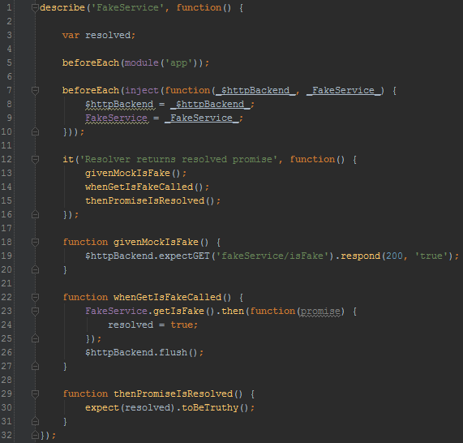
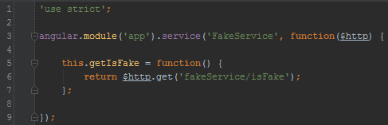
5. Unit Testing - Service

Slide 40
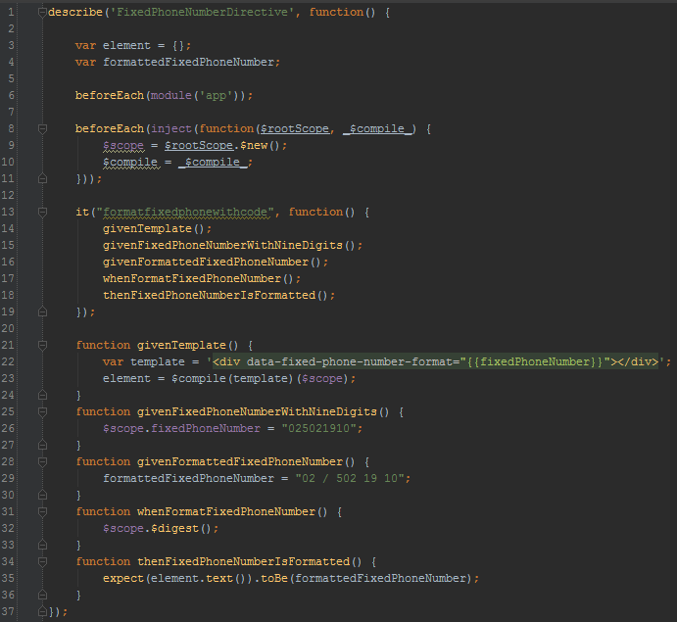
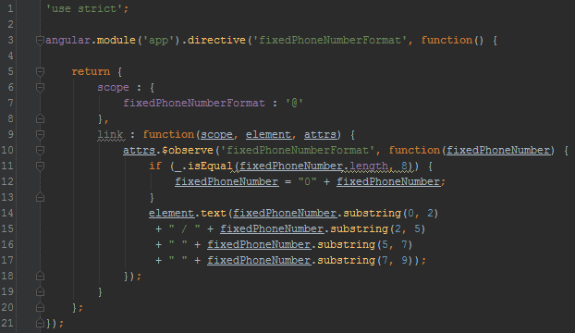
5. Unit Testing - Directive

Slide 41
6. Best practices
Always prepend any directive with “data-”
Valid HTML5
Compatible in all browsers (IE sux :))
Prefer attribute or element notation over comment and class notation
Example
<div data-my-custom-directive></div> (Preferred)
<my-custom-directive></my-custom-directive>

Slide 42
6. Best practices
Always use strict mode
Enforces better programming practices
Undefined global variables throw an error
No usage of the with statement
Create read-only properties
Create non extensible objects
...

Slide 43
6. Best practices
Wrap your components with a self executing anonymous function
Keeps the global scope clean
Better for minification

Slide 44
6. Best practices
Single responsibility
1 file per component
Directive
Service
Controller
Filter
App
..

Slide 45
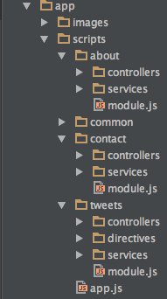
6. Best practices
Organize your files by feature
1 module per feature

Slide 46
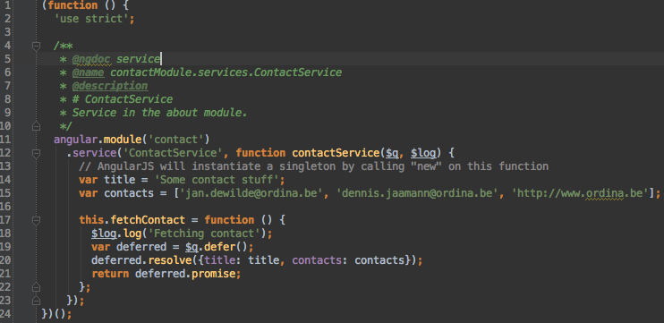
6. Best practices
Make your service methods return a promise
You can use them in route resolvers
Interpolated view expressions are smart enough to wait for the promise to resolve before rendering
For example {{somePromiseOnTheScope}}

Slide 47
6. Best practices
Create an application workflow
Yeoman
Scaffolding tool to quickly generate files and projects
You can make your project-specific tools
Grunt
Build
Test
Concatenate
Minify
CDNify
Bower
Fetch external dependencies
Integrate with CI server

Slide 48
Resources
Books
http://www.amazon.com/Mastering-Web-Application-Development-AngularJS/dp/1782161821
http://www.amazon.com/Pro-AngularJS-Experts-Voice-Development/dp/1430264489/
http://www.amazon.com/AngularJS-Brad-Green/dp/1449344852
http://www.amazon.com/ng-book-Complete-AngularJS-Ari-Lerner/dp/099134460X/
Other
https://github.com/johnpapa/angularjs-styleguide
http://www.adamcraven.me/a-better-module-structure-for-angular/
https://github.com/daniellmb/angular-test-patterns
http://trochette.github.io/Angular-Design-Patterns-Best-Practices/

